Slide 1

Data doctors
A deep insight into the covid-19 outlook up until today

Slide 2



Who we are …
Alexandros Rammos
Aspiring data –Business Analyst
Eleftherios Morits
Consultant
Our Moto is . . .
Torture the data and they will confess everything

Slide 3

Introduction
Data Doctors has been dedicated to unraveling key patterns and trends within COVID-19 data.
Today, we'll take you through:
Identification of crucial insights from the analysis
Highlighting key trends and patterns within the data
Key observations and noteworthy discoveries
Presentation of significant outcomes and results

Slide 4

Data Sources
Covid-19 Dataset
Kaggle
The dataset was provided by the Mexican government.The raw dataset consists of 21 unique features and 1,048,576 unique patients. I
The complete Our World in Data COVID-19 dataset
Our World in Data
COVID-19 dataset with cases, deaths, ICU/hospitalization metrics, testing, vaccination details, and socio-economic factors, organized by location and date.

Slide 5
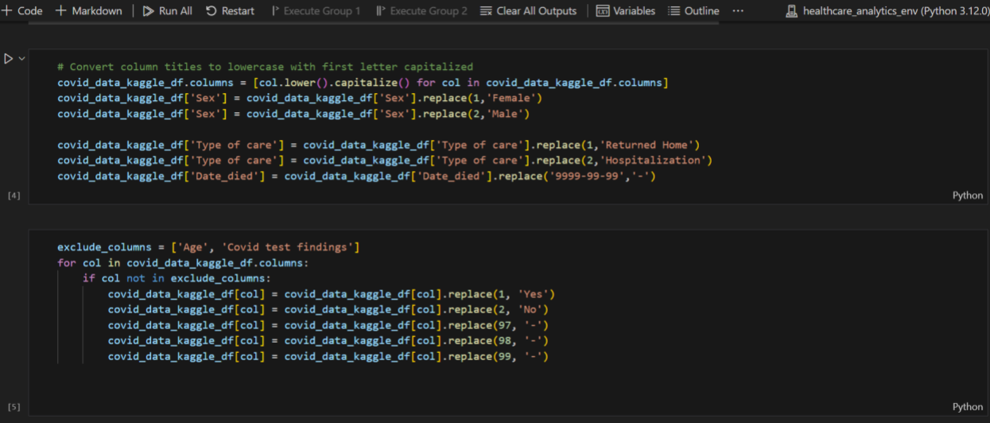



Exploratory Data Analysis (EDA) in Python
Covid-19 Dataset & Our World in Data

Slide 6
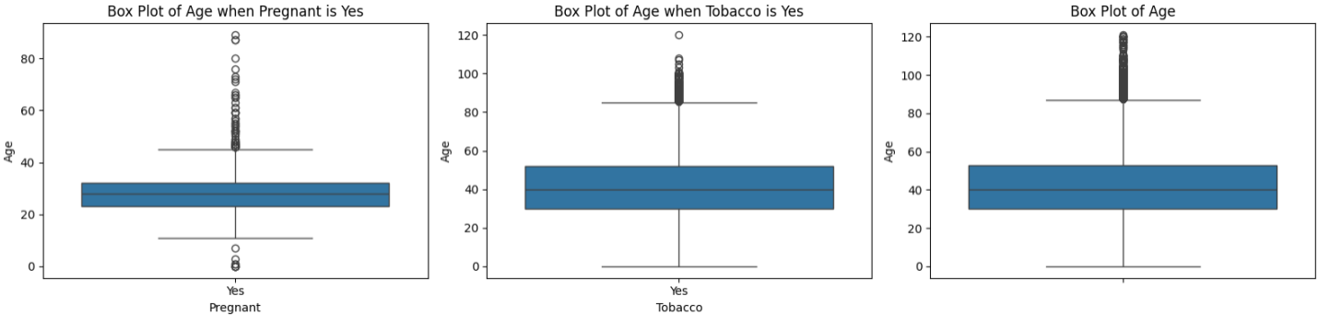
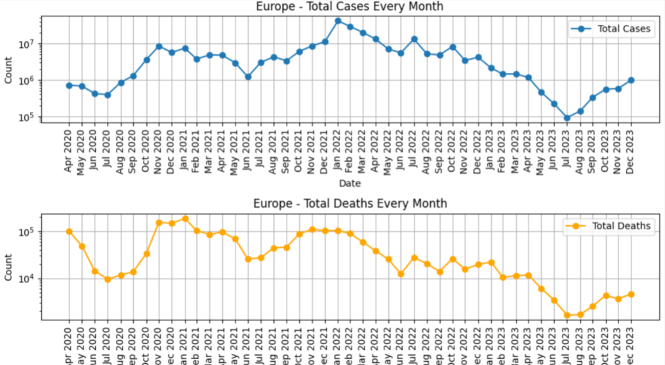
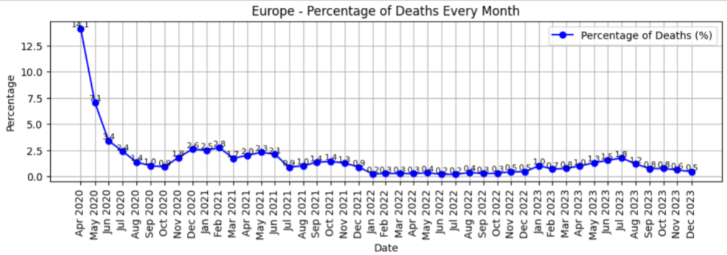
Exploratory Data Analysis (EDA) in Python
Covid-19 Dataset
Outliers' detection in ages and removal
Segmentation of ages
Our World in Data
Removal of null values and redundant columns
Findings per continent

Slide 7

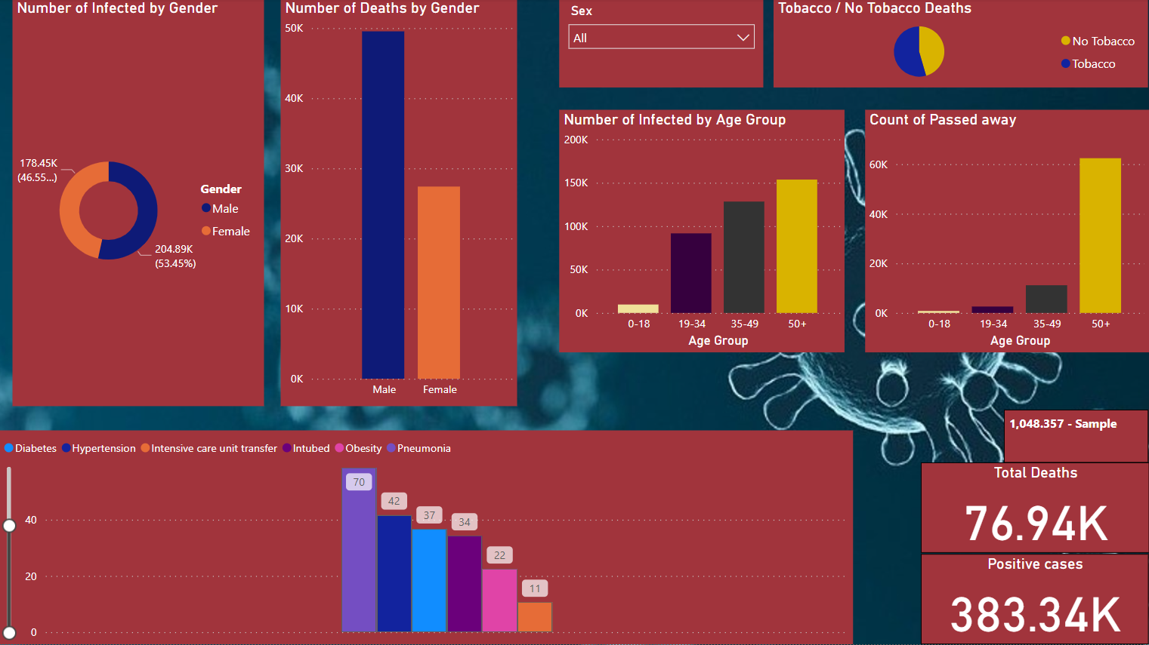
Business Intelligence (BI) Dashboard
Notes:
Number of Infected By Gender . Male higher – cases and Deaths
How diseases + covid = higher chances of death
Age group – 50 + risky age group
Tobacco – higher changes those who smoke

Slide 8
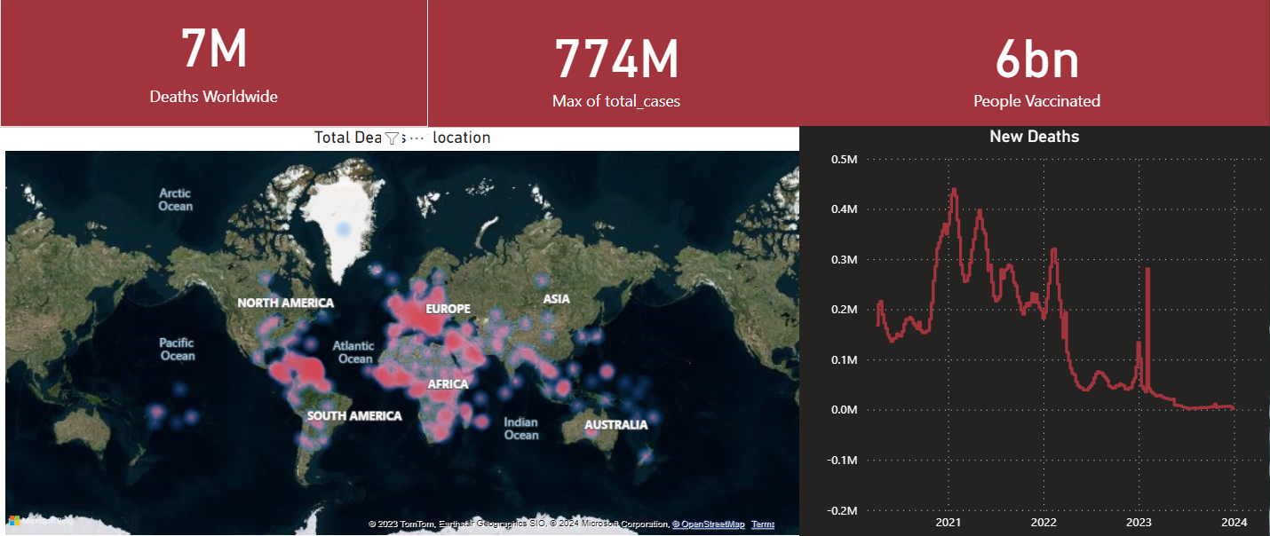
Business Intelligence (BI) Dashboard
Notes:
KPIs

Slide 9
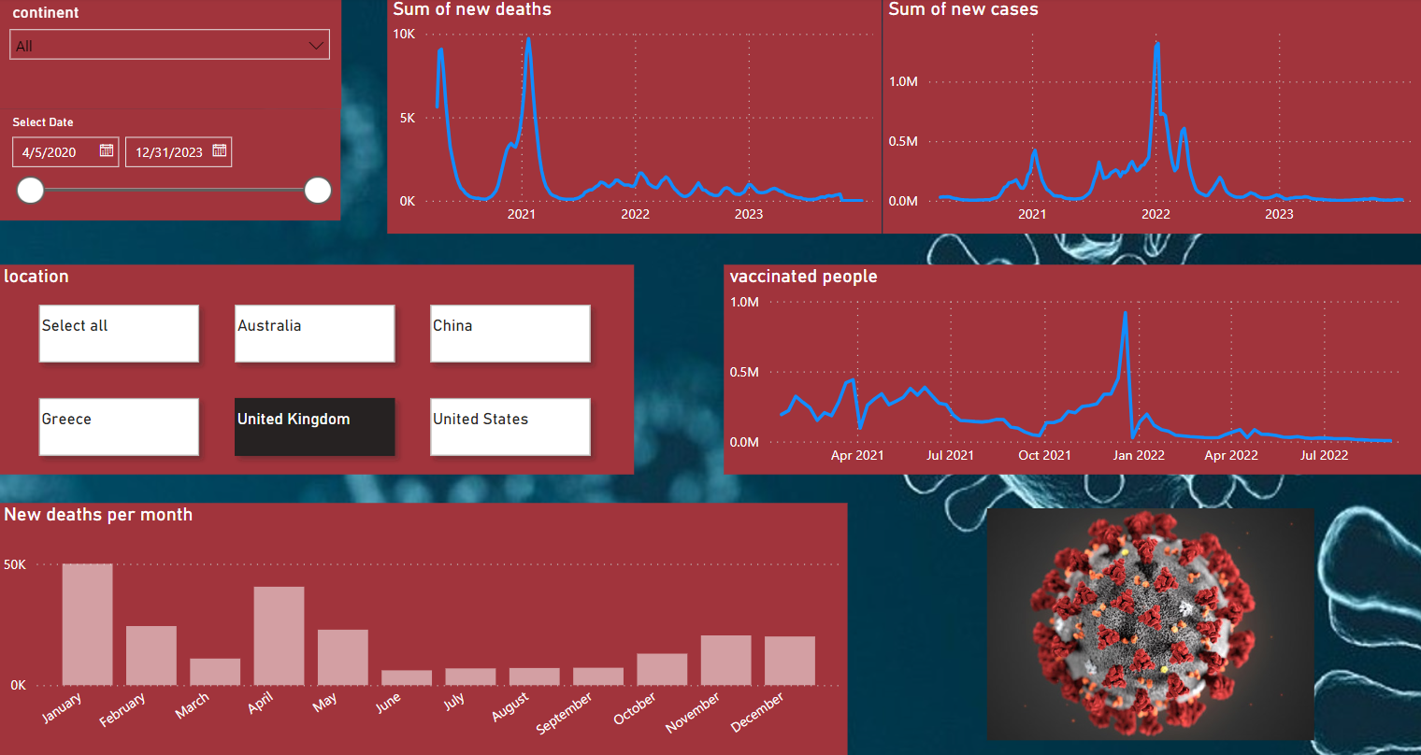
Business Intelligence (BI) Dashboard
Notes:
Using this dashboard, we can select and view data for each continent across different years.
Sum of new deaths per time
Sum of new cases – correlation
People who have been vaccinated per time
New deaths and how season is related – cold weather

Slide 10

Key Findings
Variables affecting COVID mortality
Gender : Males exhibit much higher mortality
Age Group :Individuals aged 50 + face significantly higher risks compared to younger age groups.
Diseases: We've observed that the presence of pneumonia, and diabetes, is associated with a mortality risk exceeding 70% in COVID cases.
In summary, it is evident that an increased number of new COVID cases occurs during the winter and spring, with a significant peak in 2021 leading to the highest mortality rates.
Due to widespread vaccination 6bn, there has been a notable reduction in both the occurrence of new COVID cases and the number of deaths
Notes:
Key Findings:
Gender – Age group – Diseases (pnevmonia,Diaviths,upertash)- Season – Vaccination

Slide 11



Let’s connect on LinkedIn
Alexandros Rammos Eleftherios Morits

Slide 12
Q&A
Alexandros Rammos Eleftherios Morits

